Slide 1
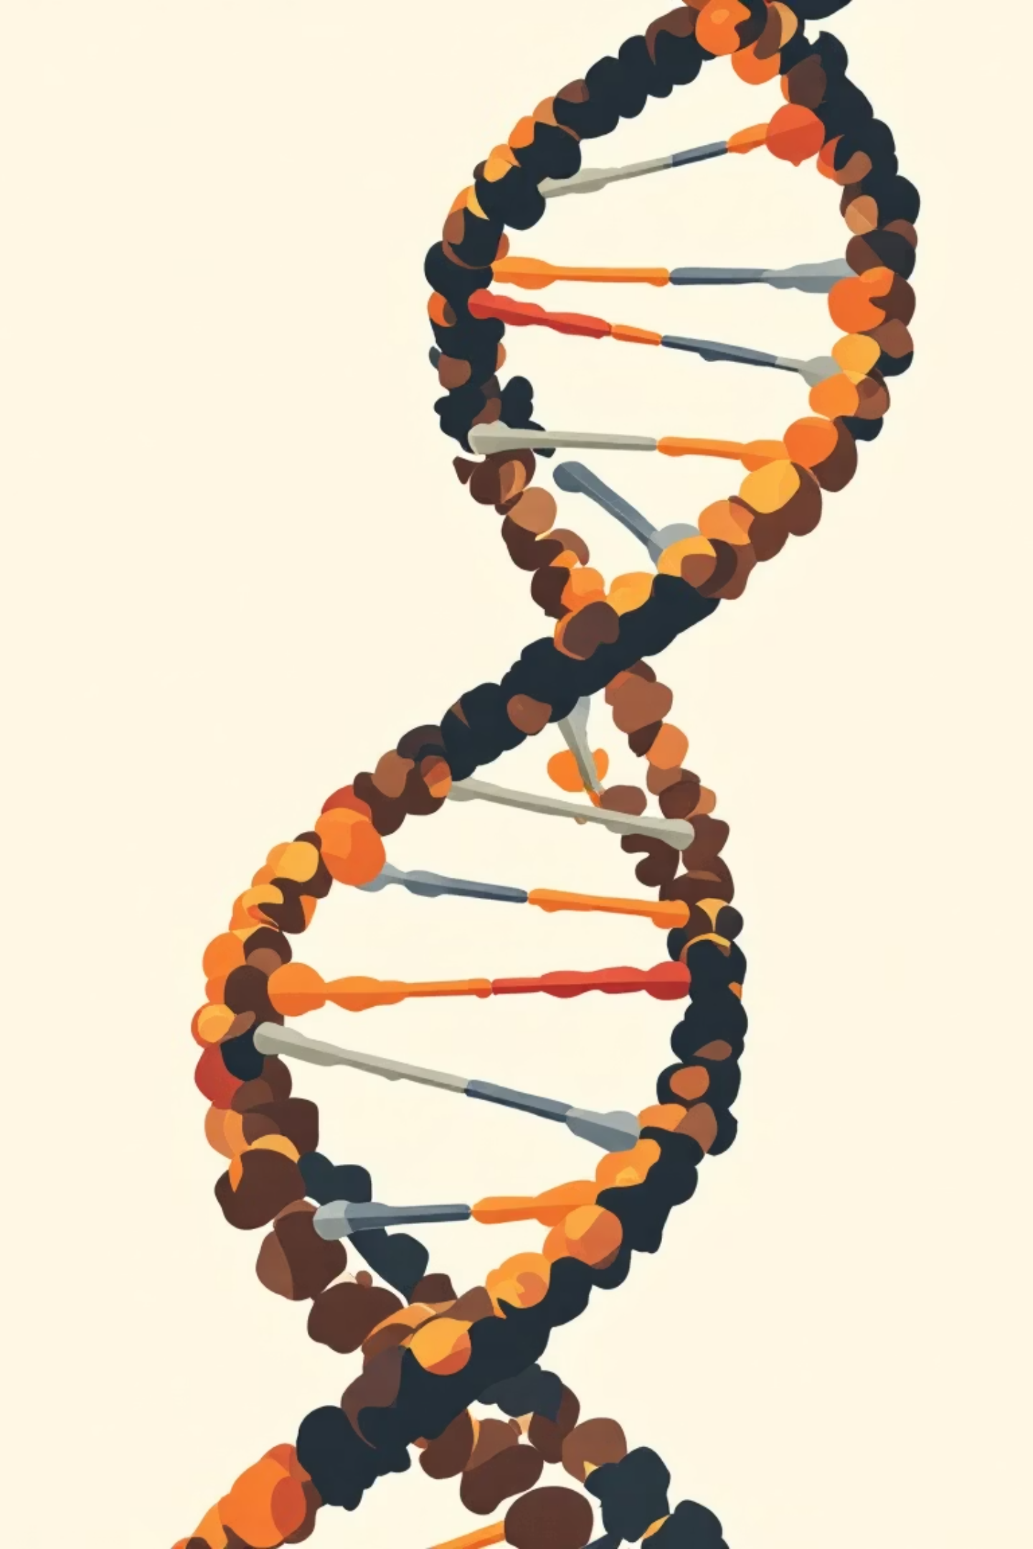
Efficient DNA Sequence Compression: A Comparative Study Huffman and Arithmetic Coding with Data Structures
Authors: Manas Kulkarni, Atharva Deshpande, Samiksha Nalawade, Revati Aute, Rajlakshmi Desai, Minal Deshmukh
Paper ID: 62
Conference: IEEE Cosmic
Track: Intelligent Systems
Institute: Vishwakarma Institute of Information Technology, Pune

Slide 2

Problem Statement
The rapid advancement in sequencing technologies has led to an exponential growth in genomic data, presenting significant challenges in storage and processing.
High Storage Demands
Slow Transfer Rates
Suboptimal Existing Tools
DNA datasets are extremely large, requiring vast amounts of storage space.
Inefficient data transfer hinders bioinformatics processing workflows.
Generic tools like Gzip and Bzip2 are not optimized for the unique structure of DNA.
Goal: Compare Huffman Coding and Arithmetic Coding for efficient DNA compression using optimized data structures.

Slide 3
Our Objective: Optimizing DNA Compression
This study aims to develop a lossless DNA compression system 2 using classical algorithms, focusing on the impact of data structure design on performance.
1
2
Lossless Compression
Data Structure Impact
Develop a system ensuring perfect reconstruction of the original DNA sequence.
Analyze how BST for Huffman and interval tables for Arithmetic coding affect efficiency.
3
4
Performance Metrics
Scalable Insights
Compare methods based on compression ratio, memory usage, encoding time, and decoding accuracy.
Provide valuable insights for designing scalable bioinformatics data storage solutions.

Slide 4





System Architecture: A Five-Layer Approach
Our proposed system integrates several modules to achieve efficient DNA sequence compression.
DNA Input Layer
User provides the sequence of nucleotides (A, C, G, T).
Frequency & Probability
Counting nucleotide occurrences and generating probabilities for Arithmetic Coding.
Huffman Coding Module
Builds BST, generates prefix-free codes, and encodes the sequence.
Arithmetic Coding Module
Assigns cumulative probability intervals and converts the sequence to a single floating-point value.
Evaluation Layer
Performs memory analysis, calculates compression ratio, measures time, and checks accuracy.

Slide 5
Huffman Coding vs Arithmetic Coding - Working Principles
Huffman Coding
Arithmetic Coding
Working Principle
Working Principle
Builds Binary Search Tree (BST) from nucleotide frequencies
Encodes the entire sequence as a fractional value in [0,1]
Uses probability-based interval updates
Higher frequency, shorter binary codes
Produces a fixed 64-bit compressed output
Generates prefix-free, variable-length codes
Strengths
Strengths
Very high compression efficiency, especially for long sequences
Fast encoding
Works well for balanced nucleotide distributions
Achieves near-entropy optimal compression
Simple and efficient tree-based structure
Handles uneven nucleotide distributions effectively

Slide 6
Experimental Setup & Memory Analysis
We utilized two synthetic DNA datasets to rigorously test the core algorithm performance, free from biological biases.
Synthetic DNA Datasets
Memory Analysis Results
Huffman Output:
Example 1 (24 nucleotides)
192 bits
Ex 1: 48 bits (0.25 ratio)
Example 2 (156 nucleotides)
1248 bits
Ex 2: 312 bits (0.25 ratio due to equal nucleotide distribution)
Using synthetic data allows for a clean performance evaluation without biological pattern bias.
Arithmetic Output:
Always 64 bits (fixed output size)
Ex 1 Ratio: 0.33
Ex 2 Ratio: 0.051 (significantly better)
Conclusion: Arithmetic Coding's efficiency dramatically increases with longer sequence lengths.

Slide 7
Compression Efficiency & Performance
Our comparative analysis highlights key differences in compression ratios and algorithm behavior.
Compression Ratio Comparison
Ex 1
0.25
0.33
Ex 2
0.25
0.051
Key Observations
Huffman's ratio remains constant for balanced datasets, regardless of length.
Arithmetic coding exhibits superior scalability for longer or uneven sequences.
Huffman offers faster execution; Arithmetic provides higher compactness.
Both algorithms achieved 100% lossless compression, with exact reconstruction and no mismatches during decoding of multiple random DNA sequences.

Slide 8
Conclusion
Both Huffman and Arithmetic Coding offer valuable solutions for DNA sequence compression, each with distinct advantages.
1
2
Significant Reduction
Huffman's Strength
Both methods notably reduce DNA storage requirements.
Faster and simpler, ideal for smaller datasets.
3
4
Arithmetic's Edge
Clear Trade-off
Achieves optimal compression for large genomic sequences.
A balance exists between compression speed and ratio.

Slide 9

Future Work
Develop hybrid Huffman-Arithmetic models for combined benefits.
Optimize algorithms for real-world genomic datasets (Gigabyte-Terabyte scale).
Integrate AI/ML methods for adaptive compression strategies.
Improve error-resilient arithmetic coding for robust applications.
Explore applications in IoT genomics, cloud storage, and medical analytics.

Slide 10
Thank You
Questions?

